Slide 1


Slide 2
Audience Recognition
Determine whether your audience is
  High tech
  Low tech
  Lay
  Multiple
2

Slide 3
High Tech Audience
Work in your field of expertise
Same department or similar capacity in other company
Can be termed as colleagues because they have
  Same educational background
  Same work experience
  Same level of understanding
Writing to high tech audience is easy.

Slide 4
Characteristics of High Tech Audience
Are experts in your field.
High tech jargon, acronyms and abbreviations can be used.
Minimal details about standard procedures or technical theories.
Little background information about a project’s history is needed.

Slide 5
Low-Tech Audience
Familiar with your field’s technology but do not know the details.
Includes
  Bosses
  Subordinates
  Co-workers in other departments.
  Colleagues in other companies.

Slide 6
Characteristics of Low-tech Audience
Familiar with your field’s technology without knowing details.
Preferable to define jargon, abbreviation and acronyms.
Define technical concepts.
Need for providing background information

Slide 7
Lay Audience
Do not work for the company and have no knowledge about your field of expertise.
Include
  Customers
  Clients
  End users
Writing to lay audience is difficult and demanding.

Slide 8
Characteristics of Lay Audience
Unfamiliar with your field’s technology.
Avoid jargon, abbreviations and acronyms or define them thoroughly.
Avoid high-tech terms or define them thoroughly.
Lay readers need background information.

Slide 9
Multiple Audience
Correspondence is not always sent to just one type of audience.
It is challenging to write for multiple audience with different levels of understanding.

Slide 10
Characteristics of Multiple Audience
1. Provide background data as some of the readers will be unfamiliar with the subject matter.
( Use references )
2. Define jargon, acronyms and abbreviations. (Within parenthesis or in a glossary)
3. Use a matter-of-fact business like tone.

Slide 11


Slide 12
High Tech Audience
  Use jargon, acronym or abbreviation alone
  HTTP
Low Tech Audience
  Use jargon, acronym or abbreviation with parenthetical definition.
  HTTP (Hypertext Transfer Protocol)

Slide 13
Lay Audience
  Use jargon, acronym or abbreviation with extended definition.
  Extended definition = Term + Type + Distinguishing Characteristics.
  HTTP (Hypertext Transfer Protocol) is a computer access code providing secure communications on networks.

Slide 14

Issues of Diversity

Slide 15
Avoid Sexist Language
Radium was discovered by a woman, Marie Curie.
Radium was discovered by Marie Curie.
Mrs Acton, an attractive blonde, is Joe’s assistant.
Mrs Acton is Joe’s assistant.
The manager is responsible for the productivity of his department.
Management is responsible for departmental productivity.
A good lawyer will make sure that his clients are aware of their rights.
A good lawyer will make sure that clients are aware of their rights.

Slide 16
Words to avoid Words to use
Mankind
Manpower
Businessmen
Policemen
Firemen
Chairman
Waiter / Waitress
  People
  Workers ,personnel
  Business people
  Police officers
  Firefighters
  Chairperson
  Server

Slide 17
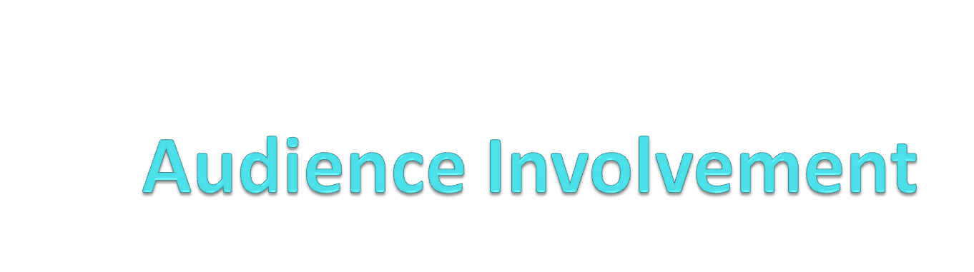
Keep your reader interested !!

Slide 18
Achieve Audience Involvement Through
Personalized Tone
  Modern technical writing is person to person communication.
Reader Benefit
  Motivate your readers by giving them what they want or need.

Slide 19
1. Personalized Tone
Names
Contractions (short forms of words)

Slide 20
2. Reader Benefit
Explain the Benefit
  State benefit early or late in the technical document.
Use Positive Verbs and Words
  We’ve received your letter complaining about our services.
  Thank you for writing to us about our services.
  We can not process your request. You failed to follow the printed instructions.
  So that we may process your request rapidly, please fill in line 6 on the printed form.

Slide 21


Slide 22
What we studied today?
Recognize the types of audience as high-tech, low-tech, lay or multiple.
How to define terms for different audience.
Avoid gender biased or sexist language.
Involve your audience through
  Personalized Tone (Use Pronouns, Names, Contractions)
  Reader Benefit ( Explain benefit and Use positive words)

